Slide 1
An Introduction to Xamarin.Forms
Fadhil
Notes:
Barkley Introduction
- CSI in general
- Need for mobile applications
- CSI’s code base (microsoft, .net, c#) to leverage on multiple platforms
- Our research into how to do this (cordova/phoneGap, native language development, xamarin)
- We decided on Xamarin – Carlo talk about that

Slide 2
About Me
Muhammad Ibnu Fadhil
Coder.Entrepreneur.Tinkerer
T: @mifmasterz / @gravicode
Founder of
PT Gravicode Multinovative Plexindo
Initiator of Gadgeteer Indonesia
https://www.facebook.com/netgadgeteerindonesia
Contributor in Makers.ID - http://makers.id
Initiator of Buitenzorg Makers Club

Slide 3



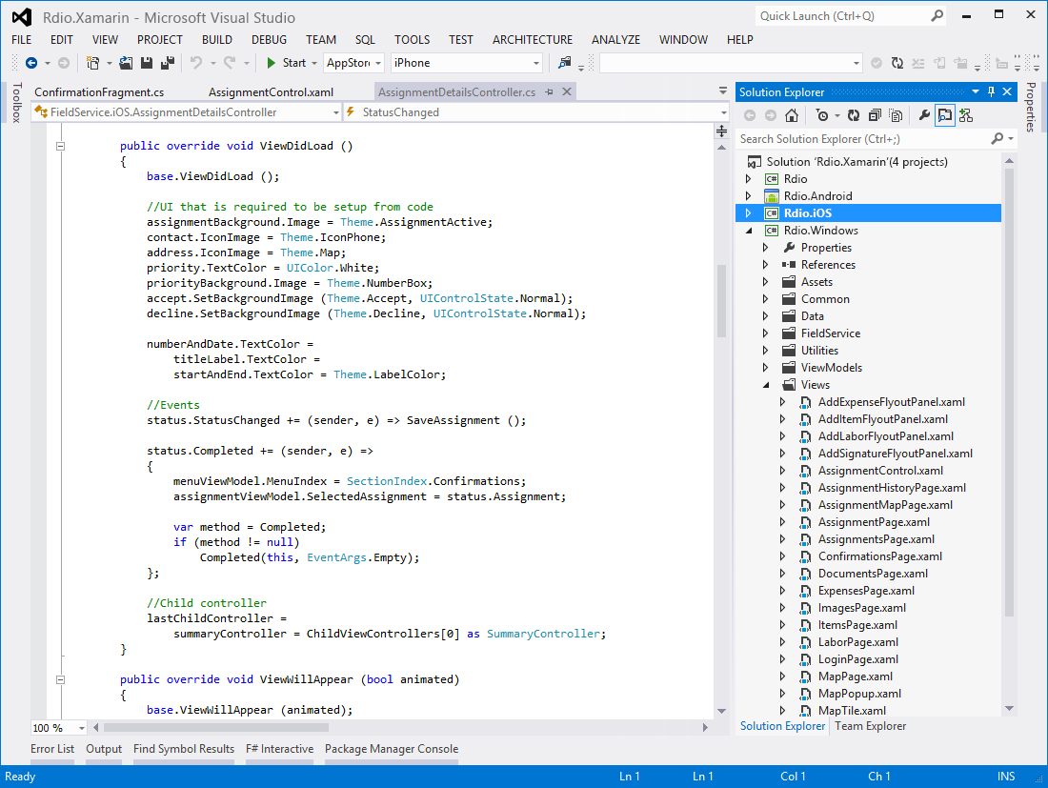
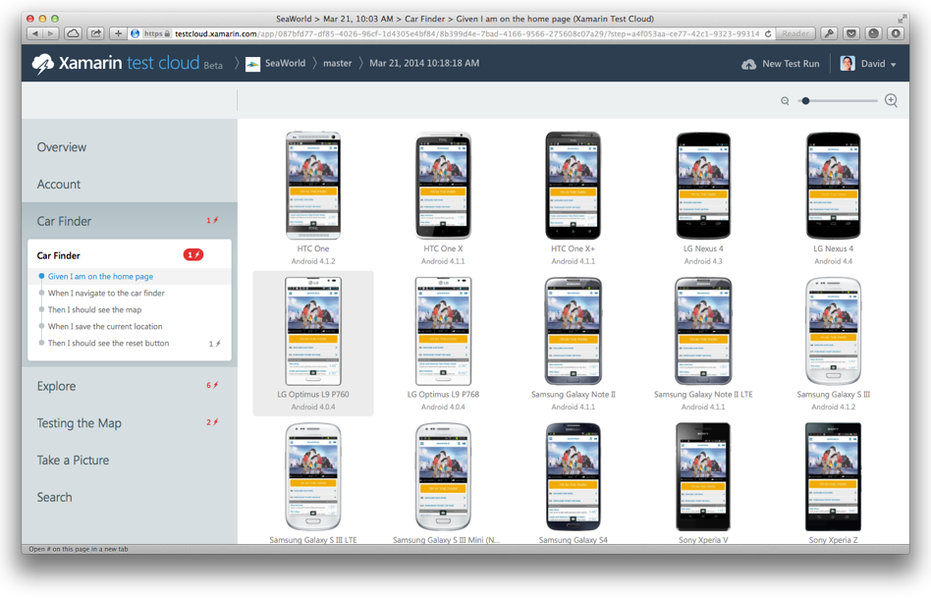
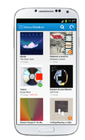
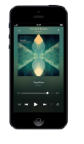
Create native iOS, Android, Mac and
Windows apps in Visual Studio and C#
Automatically test your app on
hundreds of mobile devices
Notes:
Talk about what Xamarin offers (iOS, Android, Mac using Visual Studio and C#)
If you are new to Xamarin you should know that Xamarin offers a few products.
First is the Xamarin Platform. This is what we will be talking about to today and is where we will be creating native iOS, Android, and Windows apps all in C#.
Second, is a new product called Xamarin Test Cloud. Test Cloud is a unique UI automated testing platform where you are able to create UI tests that run on hundred of physical iOS and Android devices in Xamarin’s test cloud. What is wonderful is that the Test Cloud is open to any iOS or Android mobile app regardless of what programming language or platform it was developed in.

Slide 4
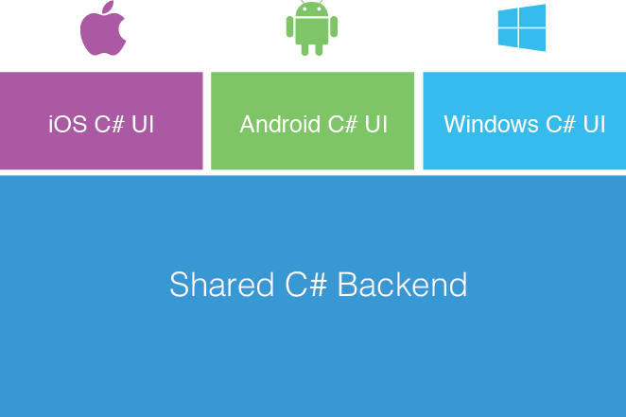
Xamarin’s Unique Approach
Native With
Code Sharing
Business Layer
Notes:
Xamarin’s unique approach enables developers to develop native iOS, Android, and Windows app while creating a shared C# backend (business logic).
You are able to leverage all of your favorite C# features such as async/await, lambas, LINQ, events, delegates, and of course the great .NET Libraries.
We are going to take a look at Xamarin.Forms today, which enables you to share more code, but let’s take a look at what Xamarin development looks like.

Slide 5
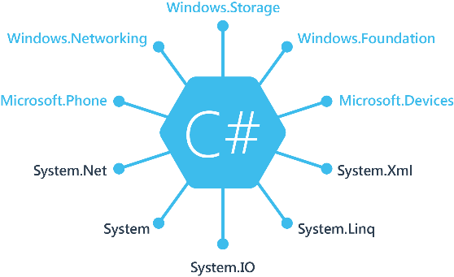
Windows APIs
Notes:
If you have ever developed for a Windows Platform before these .NET namespaces might look familiar.
However, if we go to a new platform such as Windows Phone or Store we have a new SDK to use and a new set of namespaces.

Slide 6
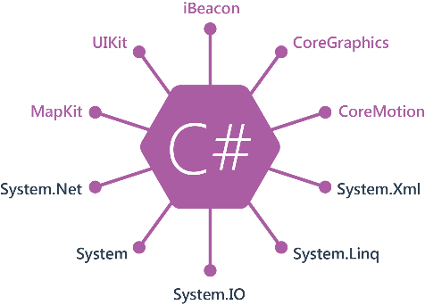
iOS APIs | 100% Coverage
Notes:
You can think of iOS and Android development the same with Xamarin. You can see we have all of our .NET namespaces and libraries, but Xamarin give us 100% api coverage of each iOS API in it’s SDK that we access view C#.

Slide 7
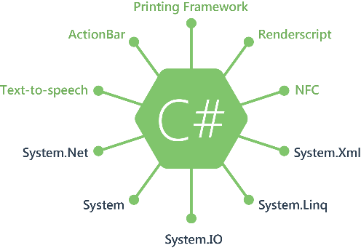
Android APIs | 100% Coverage
Notes:
The same is true for Android as well.

Slide 8
Anything you can do in Objective-C, Swift, or Java can be done in C# with Xamarin using
Visual Studio or Xamarin Studio on a Mac
Notes:
We’re going to show you both today

Slide 9
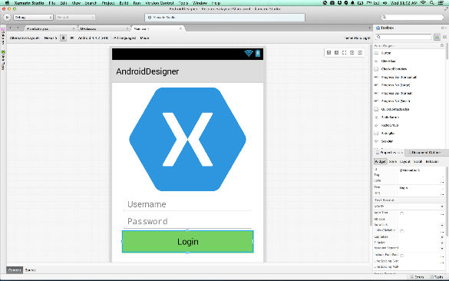
Xamarin Designer for Android
Fully integrated into Xamarin Studio & Visual Studio
Multi-resolution editing
Easy switch between design and Android XML
Shipping for over 2 years
Notes:
If you didn’t know Xamarin has shipped an Android designer for over 2 years
In both Visual Studio and Xamarin Studio
Features multi-layout view editing to make it easy to design for phone, small tablet, and large tablets

Slide 10
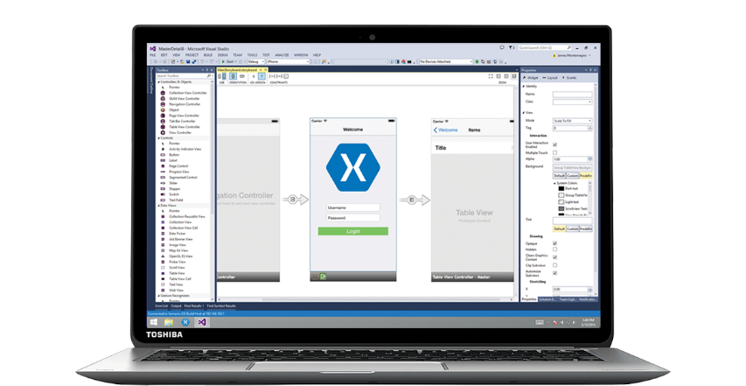
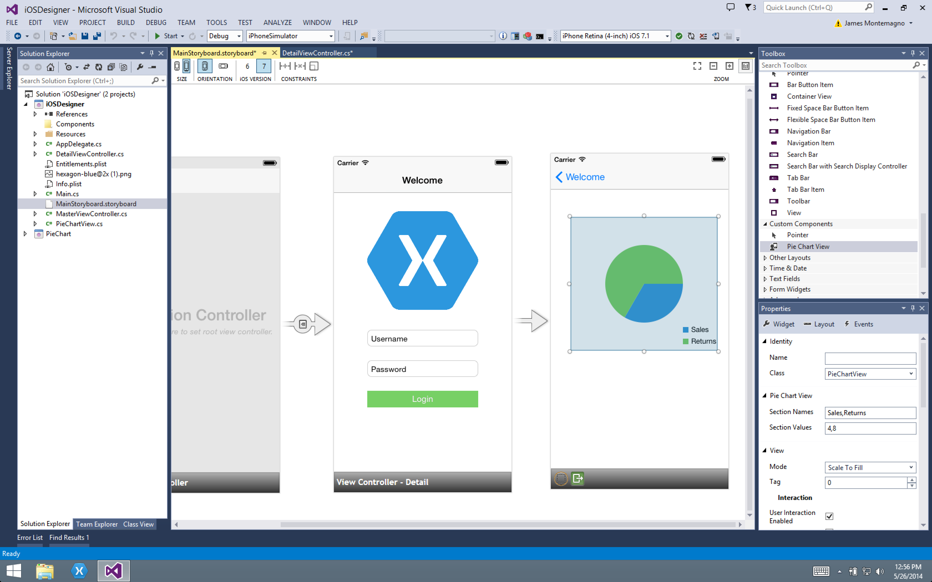
Xamarin Designer for iOS
Notes:
Short video of designer in action. You are able to use Xamarin Studio or Visual Studio for all of your development.

Slide 11
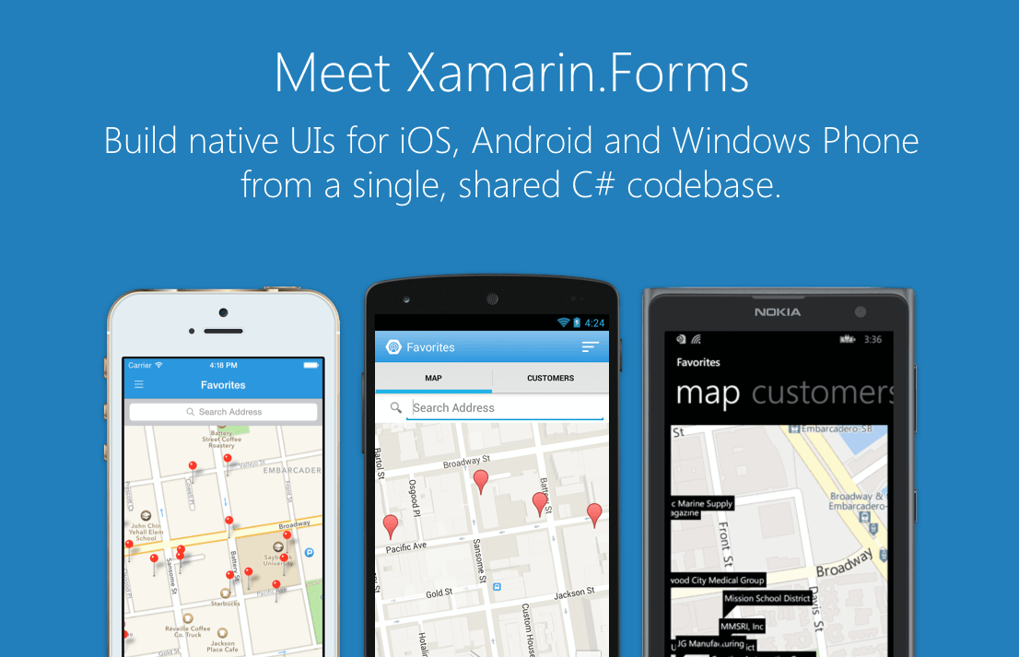
Notes:
Xamarin Forms is a new set of APIs allowing you to quickly and easily write shared User Interface code that is still rendered natively on each platform, while still providing direct access to the underlying SDKs if you need it.

Slide 12
Xamarin + Xamarin.Forms
With Xamarin.Forms:
more code-sharing, native controls
Traditional Xamarin approach
Shared UI Code
Notes:
We see here the Xamarin approach we talked about earlier
This enables you to be highly productive, share code, but build out UI on each platform and access platform APIs
With Xamarin.Forms you now have a nice Shared UI Code layer, but still access to platform APIs
You can start from native, pick a few screens, or start with forms, and replace with native later

Slide 13
What’s Included
40+ Pages, Layouts, and Controls
Build from code behind or XAML
Two-way Data Binding
Navigation
Animation API
Dependency Service
Messaging Center
Shared UI Code
Notes:
Dependency Service > give a good quick example

Slide 14
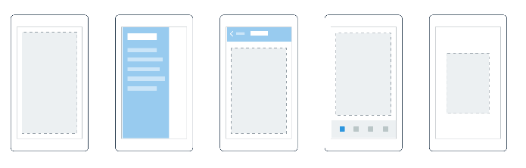

Pages
Content
MasterDetail
Navigation
Tabbed
Carousel
Notes:
First you have a set of pages for each screen of your application
There are things like Content, and MasterDetail which gives you a nice flyout
With a tabbed view you get the correct look on each platform
iOS on bottom, Android on top, and on WP you have a Pivot control

Slide 15
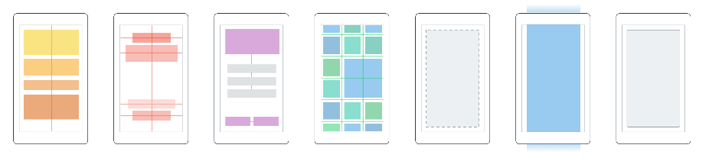
Layouts
Stack
Absolute
Relative
Grid
ContentView
ScrollView
Frame
Notes:
A lot of options from simple to complex

Slide 16
Controls
ActivityIndicator
BoxView
Button
DatePicker
Editor
Entry
Image
Label
ListView
Map
OpenGLView
Picker
ProgressBar
SearchBar
Slider
Stepper
TableView
TimePicker
WebView
EntryCell
ImageCell
SwitchCell
TextCell
ViewCell
Notes:
You have more than 40 controls, layouts, and pages to mix and match from.
These are all of the controls you have out of the box, you can of course create your own.
What is unique is you get the native control and have access to it.
Consider an Entry Field
On iOS it is mapped to UITextField
Android it is EditText
Windows Phoneit is a TextBox

Slide 17
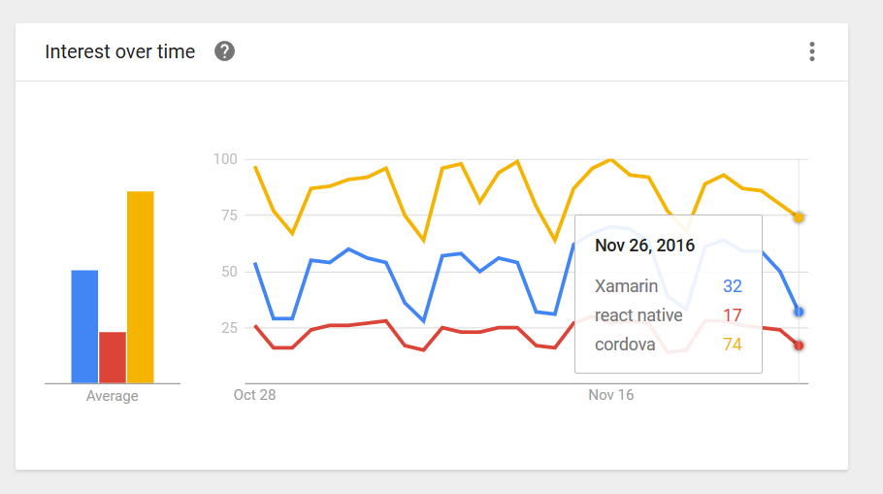
Trends

Slide 18
XAML
Extensible Application Markup Language
Notes:
Xamarin Forms is a new set of APIs allowing you to quickly and easily write shared User Interface code that is still rendered natively on each platform, while still providing direct access to the underlying SDKs if you need it.

Slide 19
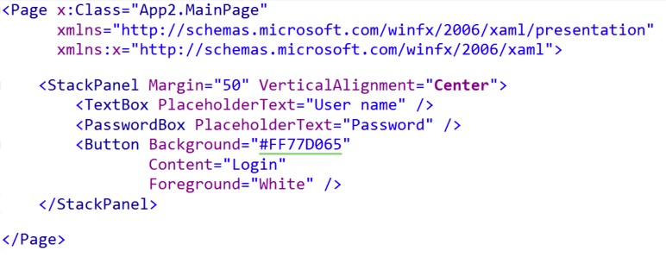
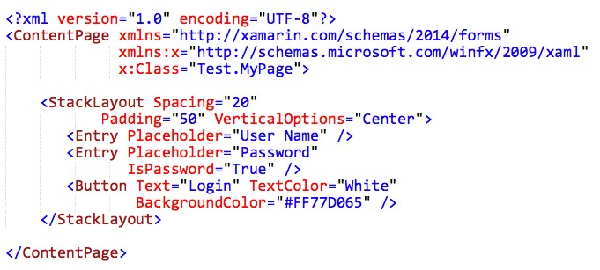
Microsoft XAML (WinRT)
Xamarin.Forms

Slide 20
Feature Supported in Xamarin.Forms
XAML 2009 compliance | ✓
Shapes (Rectangle, Ellipse, Path, etc.) | BoxView
Resources, Styles and Triggers | ✓
Data binding | *not all features
Data templates | ✓
Control templates | Custom renderers
Render Transforms | ✓
Animations | Code-only
Custom XAML behaviors | ✓
Custom markup extensions | ✓
Value converters | ✓
Navtive Control | ✓

Slide 21
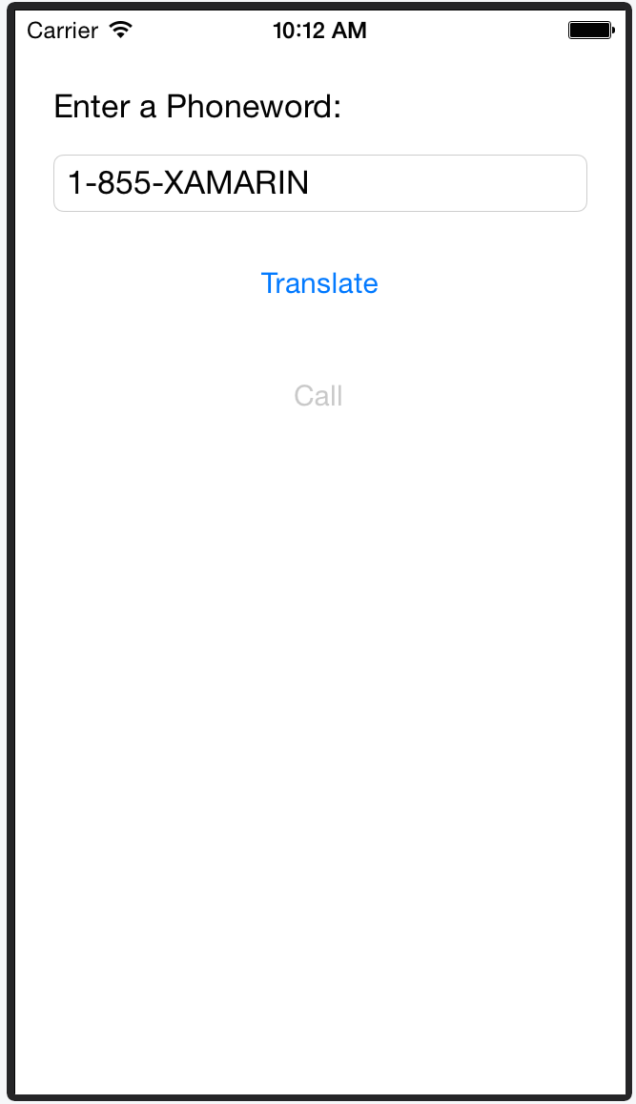
Forms ContentPage XAML
Forms ContentView XAML
Entire screen of content
Composite control (smaller than a page)

Slide 22
MVVM
Model-View-ViewModel
Notes:
Xamarin Forms is a new set of APIs allowing you to quickly and easily write shared User Interface code that is still rendered natively on each platform, while still providing direct access to the underlying SDKs if you need it.

Slide 23
WHY?

Slide 24



Model-View-ViewModel (MVVM)
MVVM is a layered, separated presentation pattern made popular by XAML based UI where a data binding engine takes the place of the controller / presenter
View
uses
data binding
ViewModel
events or observer
uses
Model

Slide 25
What is the Model?
Models manage the application data and may include any combination of domain logic, persisted state and validation, not necessarily in one object
public class Employee
{
public int Id { get; set; } public string Name { get; set; } public string Title { get; set; }
public DateTime HireDate { get; set; } public int Supervisor { get; set; } public static Employee GetById(int id);
public static void UpdateRecord(Employee employee);
}
Models are intended to be shared across platforms and should not depend on platform-specific features

Slide 26
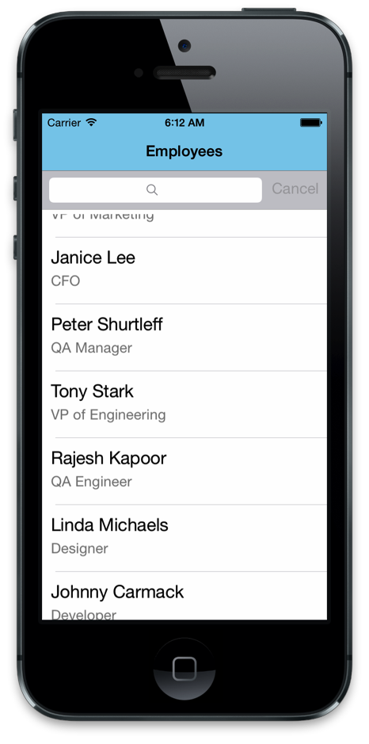
What is the View?
View presents the information to the user in a platform-specific fashion
Should not contain code you want to unit test
Everything visual should be managed here – fonts, colors, etc.

Slide 27
What is the ViewModel?
The ViewModel provides a view-centric representation of the data to display
public class EmployeeViewModel : INotifyPropertyChanged
{
private Employee model;
often has a 1:1 relationship with model
exposes bindable properties and implements property change notification
public string Name {
get { return model.Name; }
set { model.Name = value; OnPropertyChanged("Name"); }
}
public EmployeeViewModel(Employee model) { model = model;
}
...
}

Slide 28
What is the ViewModel?
… enables easier conversion / coercion of methods or model properties
partial class EmployeeViewModel
{
...
public string DateHiredText {
get { return model.HireDate.ToString("MMM d, yyyy"); }
}
public EmployeeViewModel Supervisor { get { return new EmployeeViewModel(
Employee.GetById(this.supervisor)); }
}
}

Slide 29
What is the ViewModel?
… provides bindable way to access related data
partial class EmployeeViewModel
{
...
public IEnumerable<string> ActiveProjects { get {
return CompanyProjects.All
.Where(p => p.Owner == model.Id
&& p.IsActive)
.Select(p => p.Name).ToList();
}
}
}

Slide 30
What is the ViewModel?
… and provides a convenient place to put inconvenient logic for the UI
Perform input validation prior to storing it in the model
Perform visual calculations or runtime status values for the UI
partial class DownloaderViewModel { private int percentComplete; public int PercentComplete {
get { return percentComplete; } set {
if (percentComplete != value) { percentComplete = value; OnPropertyChanged("PercentComplete");
}
}
}
}
Can use property to drive a
UI progress report

Slide 31
Creating ViewModels
Apps often have multiple view models – one for each "data- bindable" entity being displayed
Views and ViewModels often have a 1:1 relationship, but VMs can be shared across views to provide UI synchronization
MainViewModel
EmployeeViewModel
EmployeeViewModel EmployeeViewModel EmployeeViewModel
MainViewModel might expose collection of EmployeeViewModel objects to bind to a ListView

Slide 32
Connecting a View and ViewModel
Main ViewModel is most often set as the BindingContext for the view in code behind, but can also be done in XAML if preferred
public partial class MainPage : ContentPage
{
readonly MainViewModel viewModel public MainPage ()
{
BindingContext = viewModel;
InitializeComponent ();
}
...
= new MainViewModel();
}

Slide 33
MVVM Pros and Cons
MVVM is well suited for platforms with a data binding infrastructure such as Xamarin.Forms and is the preferred architecture for non-trivial apps
Pros | Cons
Provides higher testable surface Centralizes the visual & business logic Can reduce converter code used to tie models to UI Takes advantage of binding infrastructure | Requires infrastructure, more for some platforms than others Necessitates multiple layers which may not be worth it for smaller apps Bindings can be hard to debug and may not be efficient for large data sets

Slide 34


Event Handling
UI raises events to notify code about user activity
Clicked
ItemSelected
▪ …
The downside is that these events must be handled in the code behind file
Edit
Clicked
public MainPage()
{
...
Button editButton = ...; editButton.Clicked += OnClick;
}
void OnClick (object sender, EventArgs e)
{
...
}

Slide 35

Commands
Microsoft defined the ICommand interface to provide a commanding abstraction for their XAML frameworks
Edit
public interface ICommand
{
bool CanExecute(object parameter); void Execute(object parameter); event EventHandler CanExecuteChanged;
}
Command
CanExecute?
Execute(…)
Can provide an optional parameter (often null) for the command to work with for context

Slide 36




Commands in Xamarin.Forms
A few Xamarin.Forms controls expose a Command property for the main action of a control
Button
Menu
ToolbarItem
TextCell

Slide 37
Demo Time !!
Let’s create a simple app from scratch…

Slide 38
Resources
Documentation
http://developer.xamarin.com/guides/cross-platform/xamarin-forms/
XAML Documentation
http://developer.xamarin.com/guides/cross-platform/xamarin-forms/xaml-for-xamarin-forms/
Samples
https://github.com/xamarin/xamarin-forms-samples

